Slide 1
EARLY DETECTION OF BRAIN TUMOR
Submitted in the partial fulfillment for the award of the degree of
BACHELOR OF ENGINEERING
IN
COMPUTER SCIENCE AND ENGINEERING
Submitted by: K.SAI VARDHAN – 22BAI70556
P.THARUN – 22BAI70607
T.NIRAJ – 22BAI71402
N.SNEHITH – 22BAI70651
Under the Supervision of:
JASWINDER SINGH – E15978
Department of AIT-CSE
DISCOVER . LEARN . EMPOWER

Slide 2
Outline
Introduction to Project
Problem Formulation
Objectives of the work
Methodology used
Results and Outputs
Conclusion
Future Scope
References

Slide 3
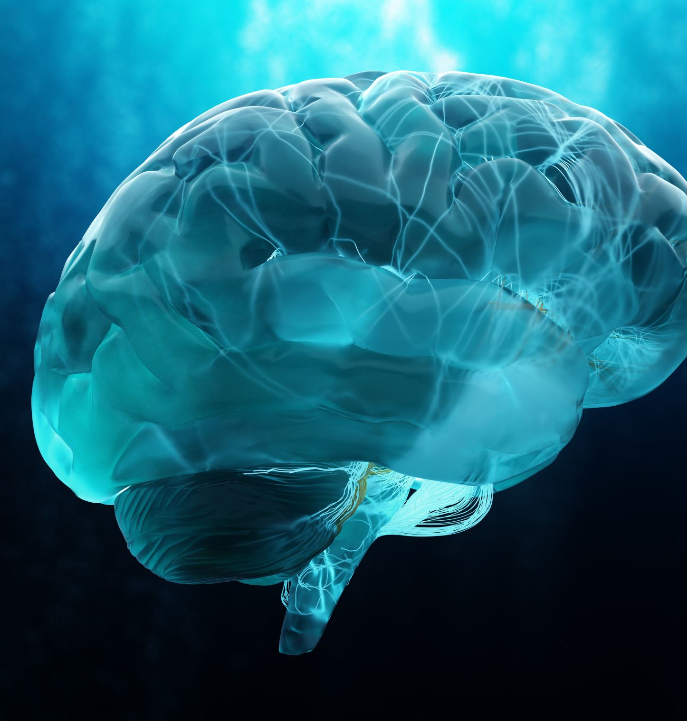
Introduction to Project
Brain tumors are abnormal growths of tissue within the brain or the central spinal canal.
They can be benign (non-cancerous) or malignant (cancerous), and their early detection is crucial for timely treatment and improved patient outcomes.
Traditional diagnostic methods rely on medical imaging techniques such as MRI (Magnetic Resonance Imaging) and CT (Computed Tomography) scans.

Slide 4
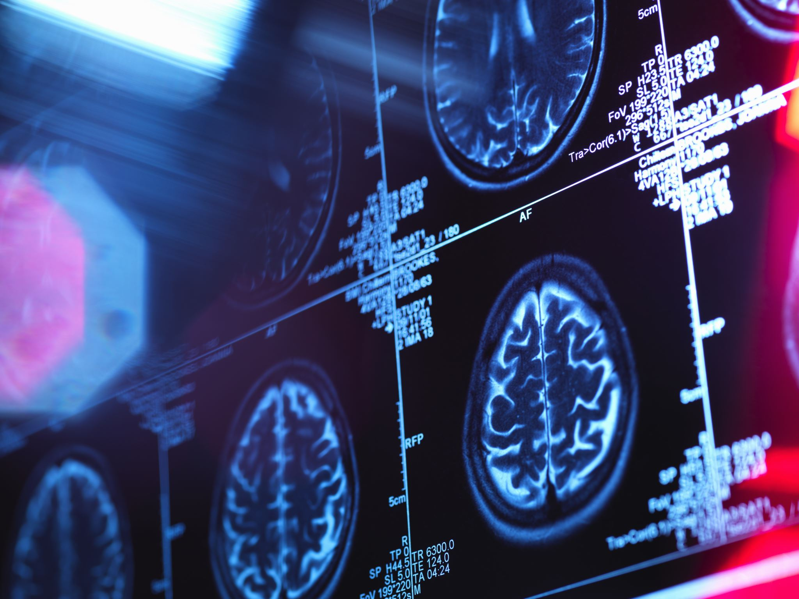
Importance
Early detection of brain tumors can significantly increase the effectiveness of treatment and patient survival rates.
Accurate diagnosis allows for timely intervention, reducing the risk of complications and improving the quality of life for affected individuals.
Challenges
Brain tumors can vary greatly in size, location, and characteristics, making accurate detection challenging.
Interpreting medical imaging data requires expertise and may be subject to human error.

Slide 5
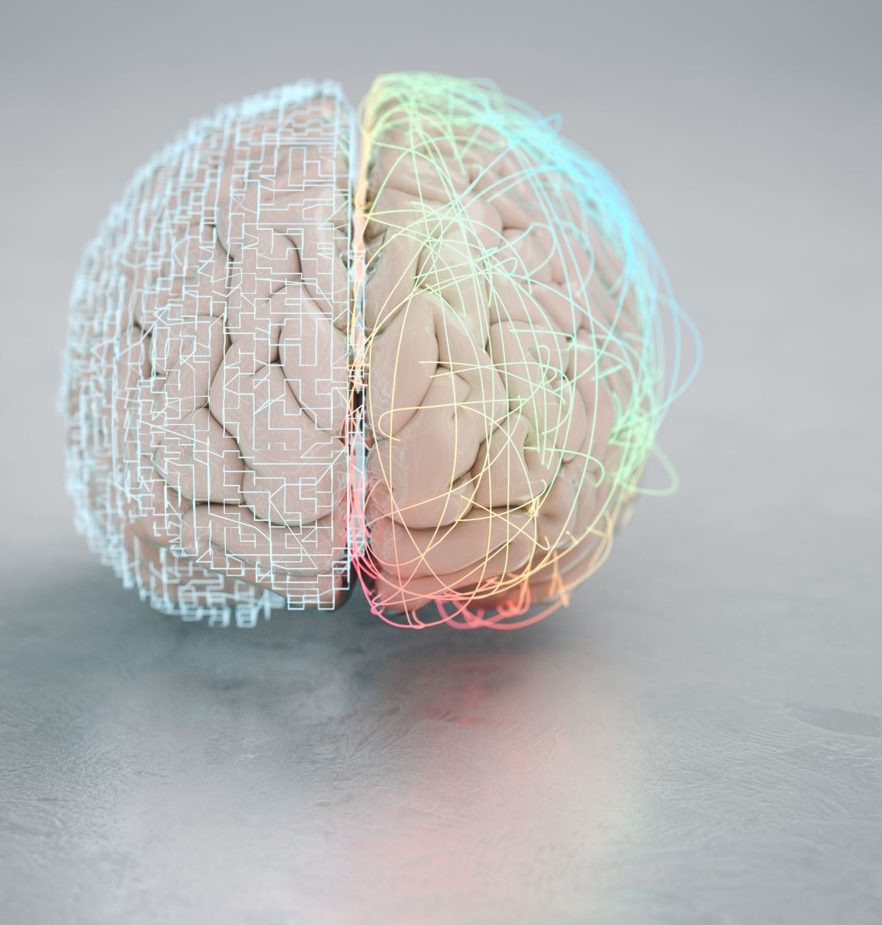
Problem Formulation
Overview:
Brain tumors pose a significant health challenge globally, affecting individuals of all ages.
The need for accurate and timely detection is paramount due to the potential severity of brain-related conditions and their impact on patients' lives.
Statistics:
According to the World Health Organization (WHO), approximately 180,000 new cases of brain tumors are diagnosed worldwide each year.
Early detection can lead to more effective treatment options and better outcomes, yet many cases are not diagnosed until later stages, reducing treatment success rates.

Slide 6
Need for Automation:
Manual interpretation of medical imaging data for brain tumor detection is time-consuming and prone to errors.
Developing automated detection systems can significantly improve diagnostic efficiency and accuracy.
Potential Benefits:
Early detection through automated systems can facilitate prompt medical interventions, potentially saving lives and reducing healthcare costs.
Automation can also streamline the diagnostic process, allowing healthcare professionals to focus more on patient care and treatment planning rather than spending extensive time on image analysis.

Slide 7

Objectives of the Work
Develop an automated system for the detection of brain tumors using medical imaging data, such as MRI and CT scans.
Improve diagnostic accuracy and efficiency through the implementation of machine learning algorithms and image processing techniques.
Enable early detection of brain tumors to enhance patient outcomes, treatment effectiveness, and overall healthcare efficiency.
Facilitate interdisciplinary collaboration between medical professionals, computer scientists, and data scientists to leverage expertise and advance brain tumor detection technology.

Slide 8

Methodology used
Our methodology integrates machine learning algorithms and image processing techniques to develop an automated system for brain tumor detection.
The Automated system for brai tumor detection will preprocess the images and compare the images with the key image to check whether the image of the patient has brain tumor or not
The workflow involves multiple stages, including data preprocessing, feature extraction, classification, and result visualization.

Slide 9
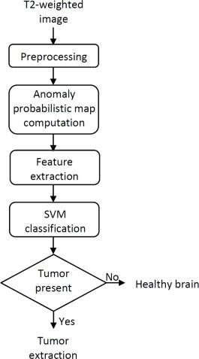
Data Preprocessing:
Cleaning and standardization of medical imaging data to ensure consistency and quality.
Feature Extraction:
Extraction of relevant features from the preprocessed images to capture tumor characteristics.
Classification:
Utilization of machine learning algorithms (e.g., convolutional neural networks) to classify images as either tumor or non-tumor.
Result Visualization:
Visualization of classification results for interpretation by healthcare professionals, aiding in diagnosis and treatment planning.

Slide 10
Results and Outputs
Our system achieved an accuracy of [0.99], indicating its ability to correctly classify tumor and non-tumor images with high precision.
Our system demonstrated a sensitivity and specificity of [0.99], indicating its ability to accurately detect tumors while minimizing false positives and false negatives.
Our system achieved an AUC of [0.98], indicating its robust performance in distinguishing between tumor and non-tumor images across different thresholds.

Slide 11
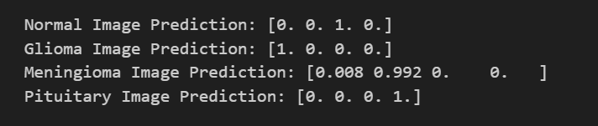
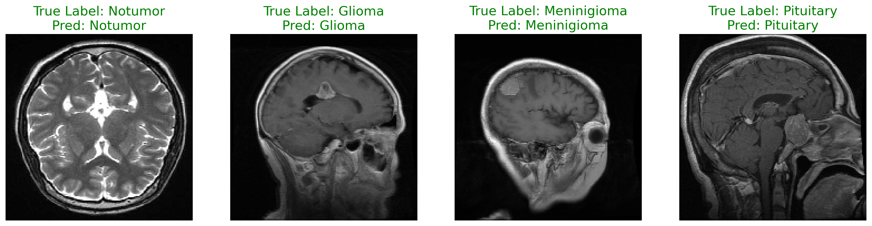

Slide 12
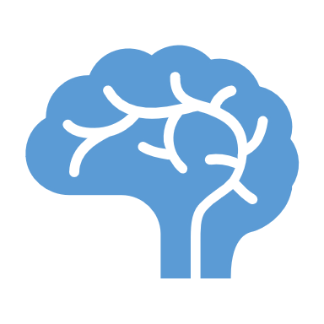
Conclusion
Our brain tumor detection project represents a significant advancement in medical imaging technology, offering a promising solution for early diagnosis and treatment of brain tumors. While challenges were encountered, our collaborative efforts have resulted in a robust system with the potential to positively impact patient care and healthcare outcomes.

Slide 13

Future Scope
Enhanced Diagnostic Accuracy: Further refinement of machine learning models and image processing techniques to improve the accuracy and reliability of brain tumor detection.
Integration of Multi-Modal Imaging: Incorporating multiple imaging modalities (e.g., MRI, CT, PET) and clinical data for comprehensive tumor characterization and personalized treatment planning.
Real-Time Detection: Development of real-time detection systems for instantaneous analysis of medical imaging data, enabling prompt diagnosis and intervention during surgical procedures.
Artificial Intelligence in Treatment Planning: Utilization of artificial intelligence algorithms to assist in treatment planning, such as surgical navigation systems and personalized radiotherapy dosing.

Slide 14
References
Brownlee, J. (2021). How to Develop Deep Learning Models with Keras. Machine Learning Mastery.
Chakrabarty, Navoneel. Brain MRI Images for Brain Tumor Detection. Disponível em: [link para o conjunto de dados].
Charron, O., Lallement, A., Jarnet, D., & Clarysse, P. (2018). Brain Tumor Segmentation and Tractography from Multi-Sequence MRI: A Deep Learning Approach. Frontiers in Neuroscience, 12, 1011.
Chollet, F. (2017). Deep Learning with Python. Manning Publications.
Cubuk, E. D., Zoph, B., Mane, D., Vasudevan, V., & Le, Q. V. (2019). AutoAugment: Learning Augmentation Policies from Data. In Proceedings of the IEEE Conference on Computer Vision and Pattern Recognition (pp. 113-123).
Havaei, M., Davy, A., Warde-Farley, D., Biard, A., Courville, A., Bengio, Y., ... & Pal, C. (2017). Brain tumor segmentation with deep neural networks. Medical Image Analysis, 35, 18-31.

Slide 15
Isensee, F., Kickingereder, P., Wick, W., Bendszus, M., & Maier-Hein, K. H. (2018). Brain Tumor Segmentation and Radiomics Survival Prediction: Contribution to the BRATS 2017 Challenge. In International MICCAI Brainlesion Workshop (pp. 287-297). Springer, Cham.
Menze, B. H., Jakab, A., Bauer, S., Kalpathy-Cramer, J., Farahani, K., Kirby, J., ... & Weber, M. A. (2015). The multimodal brain tumor image segmentation benchmark (BRATS). IEEE Transactions on Medical Imaging, 34(10), 1993-2024.
Perez, L., & Wang, J. (2017). The Effectiveness of Data Augmentation in Image Classification using Deep Learning. arXiv preprint arXiv:1712.04621.
Shorten, C., & Khoshgoftaar, T. M. (2019). A survey on Image Data Augmentation for Deep Learning. Journal of Big Data, 6(1), 60.
Simonyan, Karen, & Zisserman, Andrew. (2015). Very Deep Convolutional Networks for Large-Scale Image Recognition. arXiv preprint arXiv:1409.1556.
Saeed, R., & Al-Jumaily, A. (2021). A Comprehensive Review of Convolutional Neural Network Architectures in Brain Tumor Image Segmentation. Journal of Healthcare Engineering, 2021.

